Slide 1


ECEN 403 Midterm Presentation
RADIAN - RADar Intelligent Activity moNitoring Presented by: Matthew Blackwell, Wyatt Johnson, Mitch Hoffman
TA: Roman Venegas
Sponsor: Dr. Arya Menon

Slide 2
Project Summary
Problem statement:
State/succinctly describe the problem that warrants spending the time, effort, and cost to develop a product or service to address the problem.
“Because the sponsor told us”, listing 3 or 4 or 11 problems, and casting a solution as a problem “lack of a deployed LLM for dentistry” are NOT problem statements
ONE OVERALL PROBLEM!
Our Solution:
What is the major contribution of your product that solves/addresses this problem.
DO NOT list 3 or 11 characteristics of your system and expect the listener to figure out how this solve the problem you stated above
Good ENGINEERING figure here…eg plot showing the trend of the problem getting worse, figure showing a failed product, good logo for your product, …
Draw a picture of your proposed solution. Show all the pieces and how they are connected to build the final product. This is NOT the FSR block diagram but a cartoon/picture.
DO NOT show two paragraphs!

Slide 3

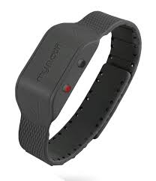
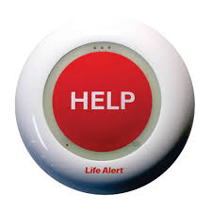
Problem Statement
Falls are the leading cause of injury in elderly
Fast detection saves lives through quick response
Current Solutions - Limitations:
Wearables → must be worn and charged
Push-buttons → user must be conscious/able to press
Camera → effective but invade privacy

Slide 4
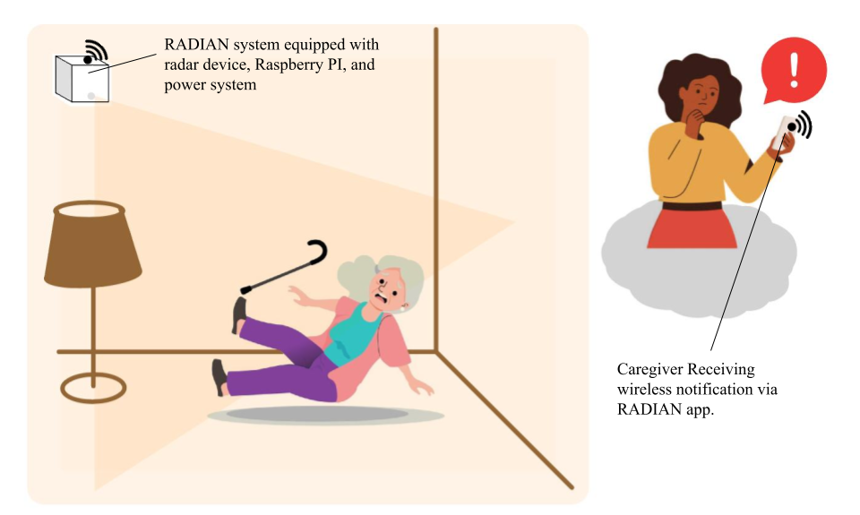
RADIAN System Summary
Proposed Solution:
Automatic Fall Detection
Works in real time
No user action needed
Privacy-Preserving
No camera
Protects independence
Reliable Response
Immediate accurate alerts to caregivers

Slide 5
System Overview
Team member 3 name
Team member 1 name
This figure should clearly show what HW & SW are being developed / integrated into each subsystem. Some interconnected boxes showing how subsystems will be connected for system.
Owner should be clear … name and color code
Interfaces – arrows between boxes, where known should be labeled…Bluetooth, I2C, Websocket
Push notifications, USB, LORA, …
NOT TOO MUCH DETAIL!
Team member 4 name
Team member 2 name
Notes:
Cloud server and database

Slide 6
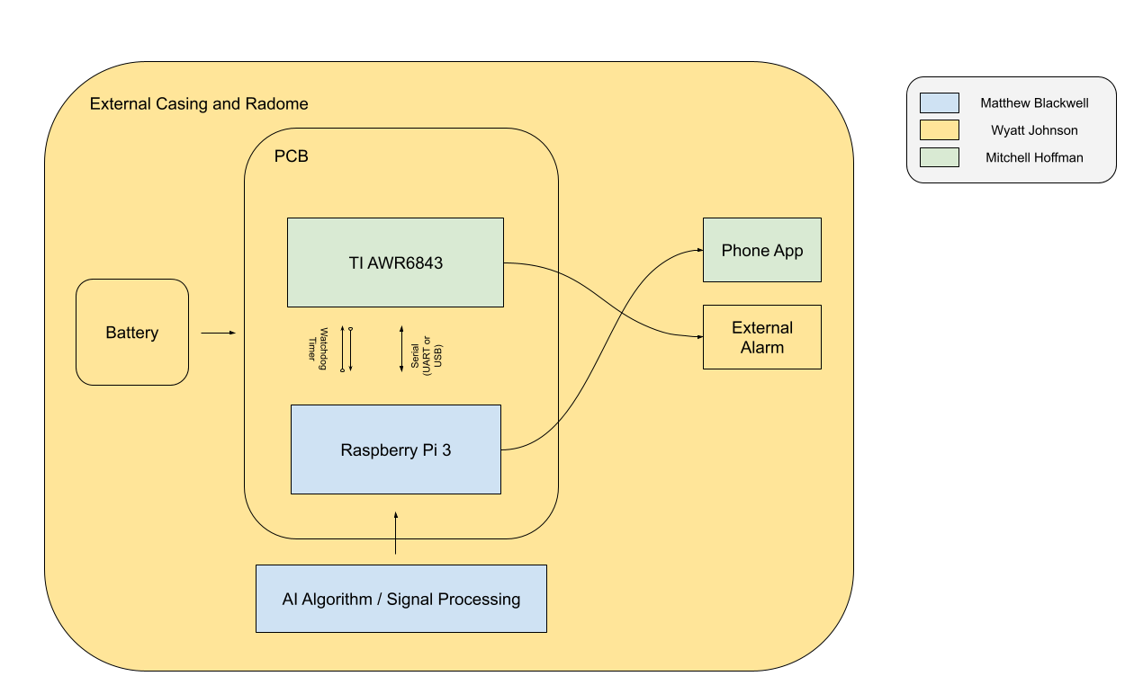
System Overview

Slide 7
Subsystem 1 – OWNER NAME
Good ENGINEERING figure here showing details of what is being developed….don’t show blocks of code or sheets of schematics. Don’t show clip-art or stock images or powerpoint handshakes, emojis, …
What does the subsystem do?
How is it being designed (what design tools, what parts eg. MCU type, key mechanicals,…)
Key objectives, constraints, metrics (from FSR)
How will it connect to and interact with other subsystems (from ICD)
If you have picked SW language, parts, show a tradeoff table that led you to that decision
Use a subsystem name instead of Subsystem 1,2,3,4 such as App/Database, MCU and Sensors, Power System, ML for Image Processing, etc.

Slide 8
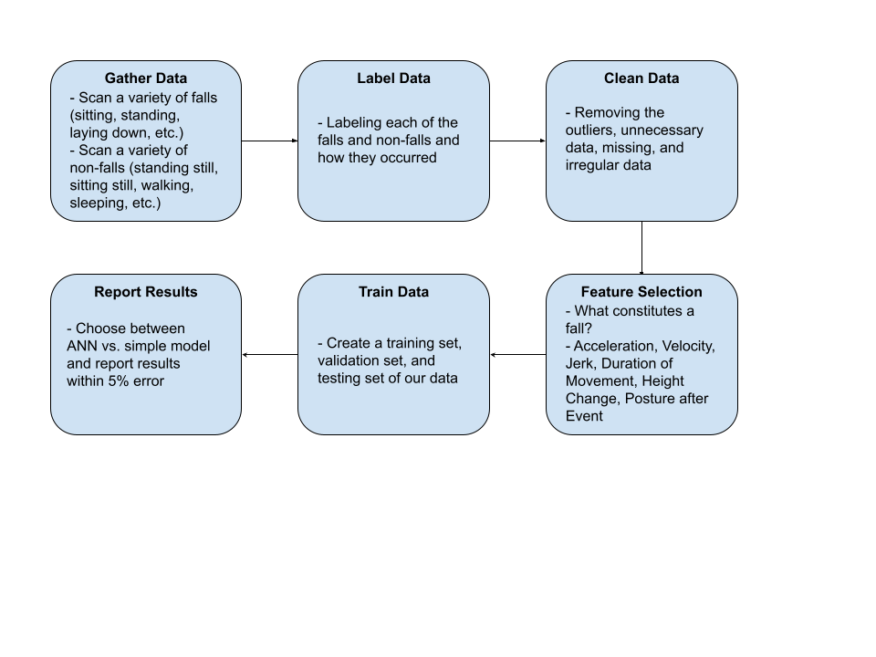
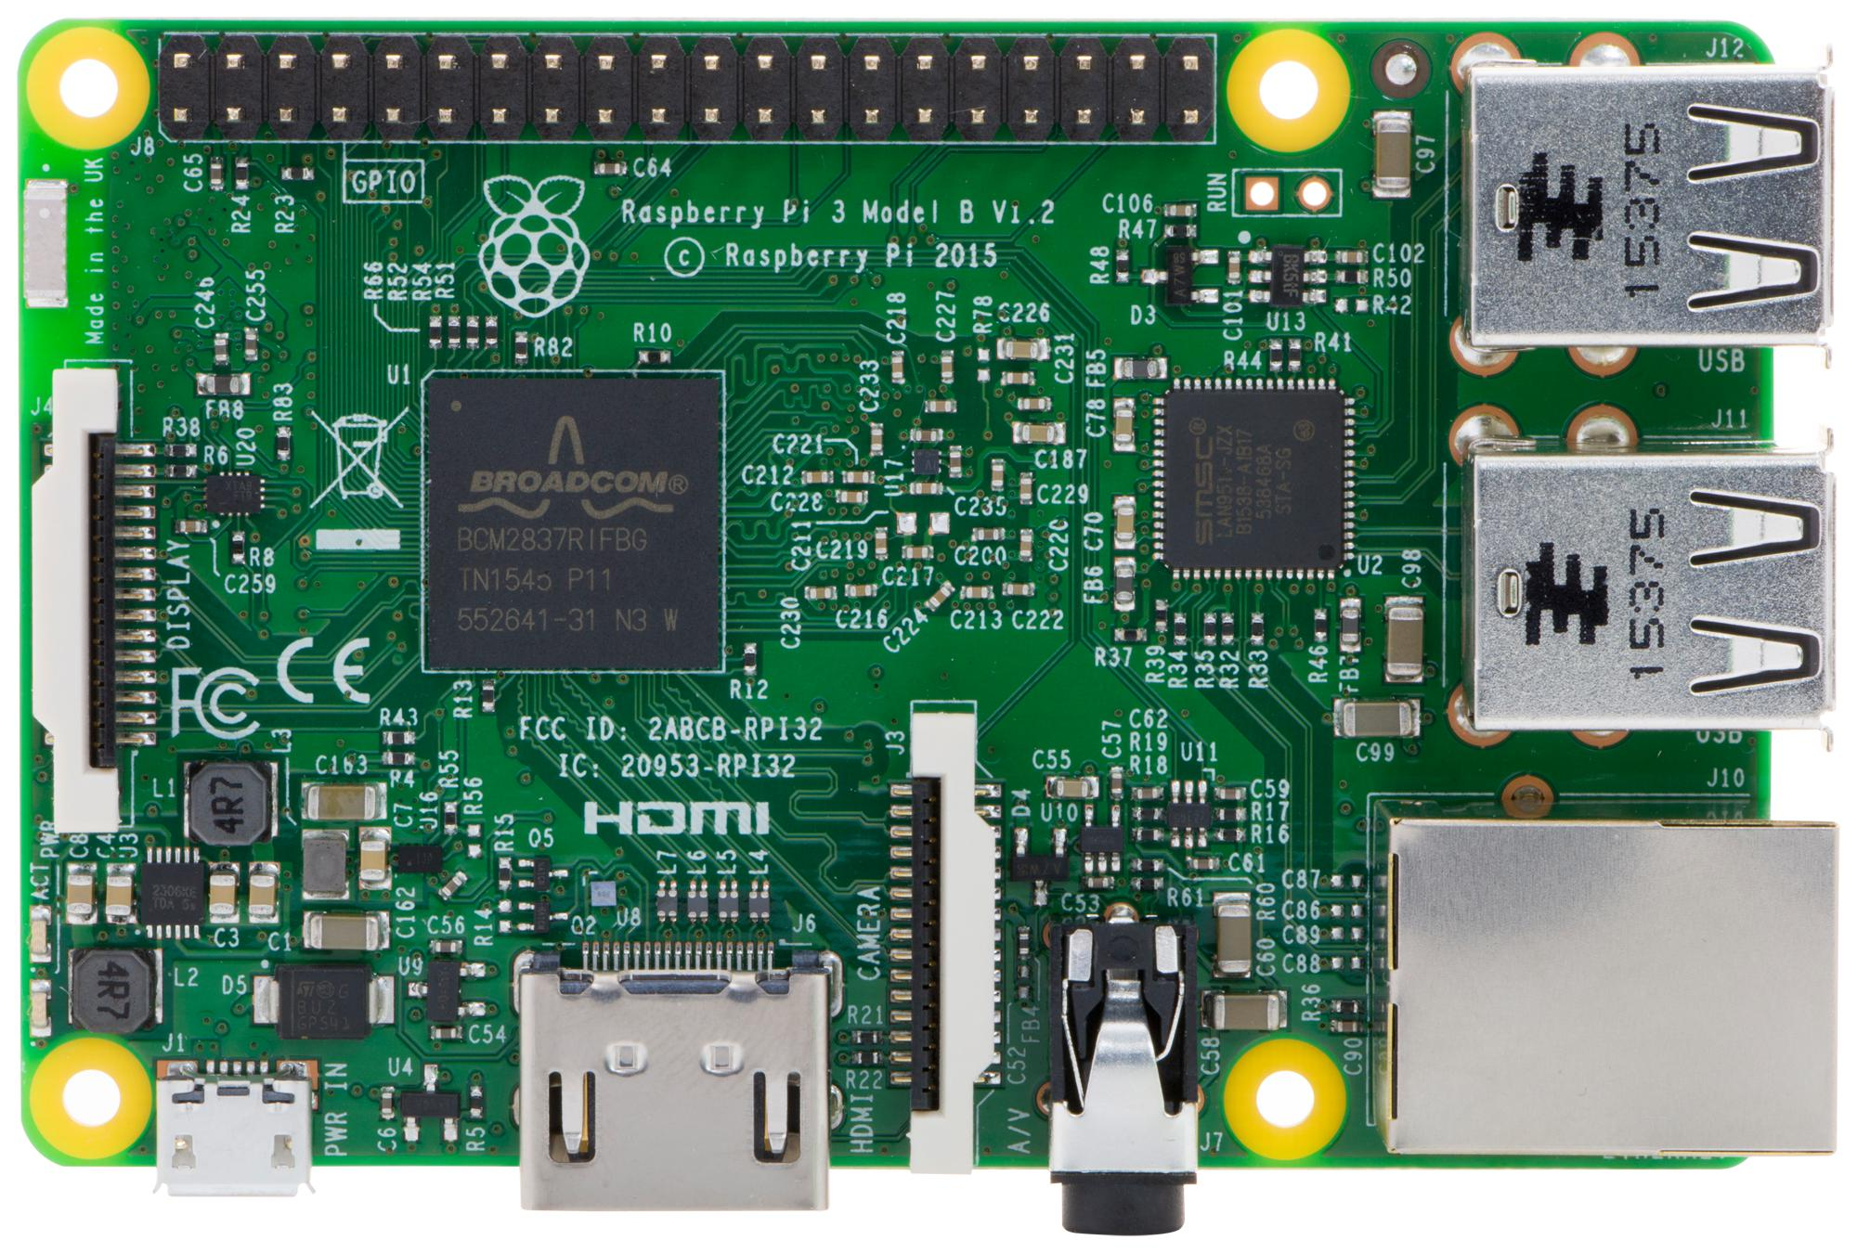
Data - Matthew Blackwell
Subsystem Function:
Provide an accurate ML model for determining if a fall occurred
Design Overview:
Raspberry Pi 3
Python
Scikit & Panda
Constraints:
Number of data tests
Compatibility with TI Board
ANN vs. Simple ML model

Slide 9
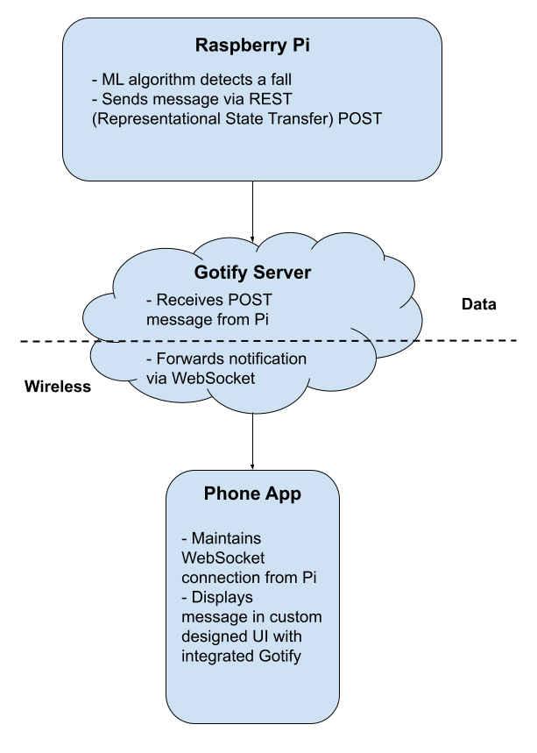

Data - Matthew Blackwell
Subsystem Function:
Design and create a Python script
to send message to Gotify server
Design Overview:
Raspberry Pi 3
Gotify to send Push Notifications
Constraints:
Integration with the TI Board

Slide 10
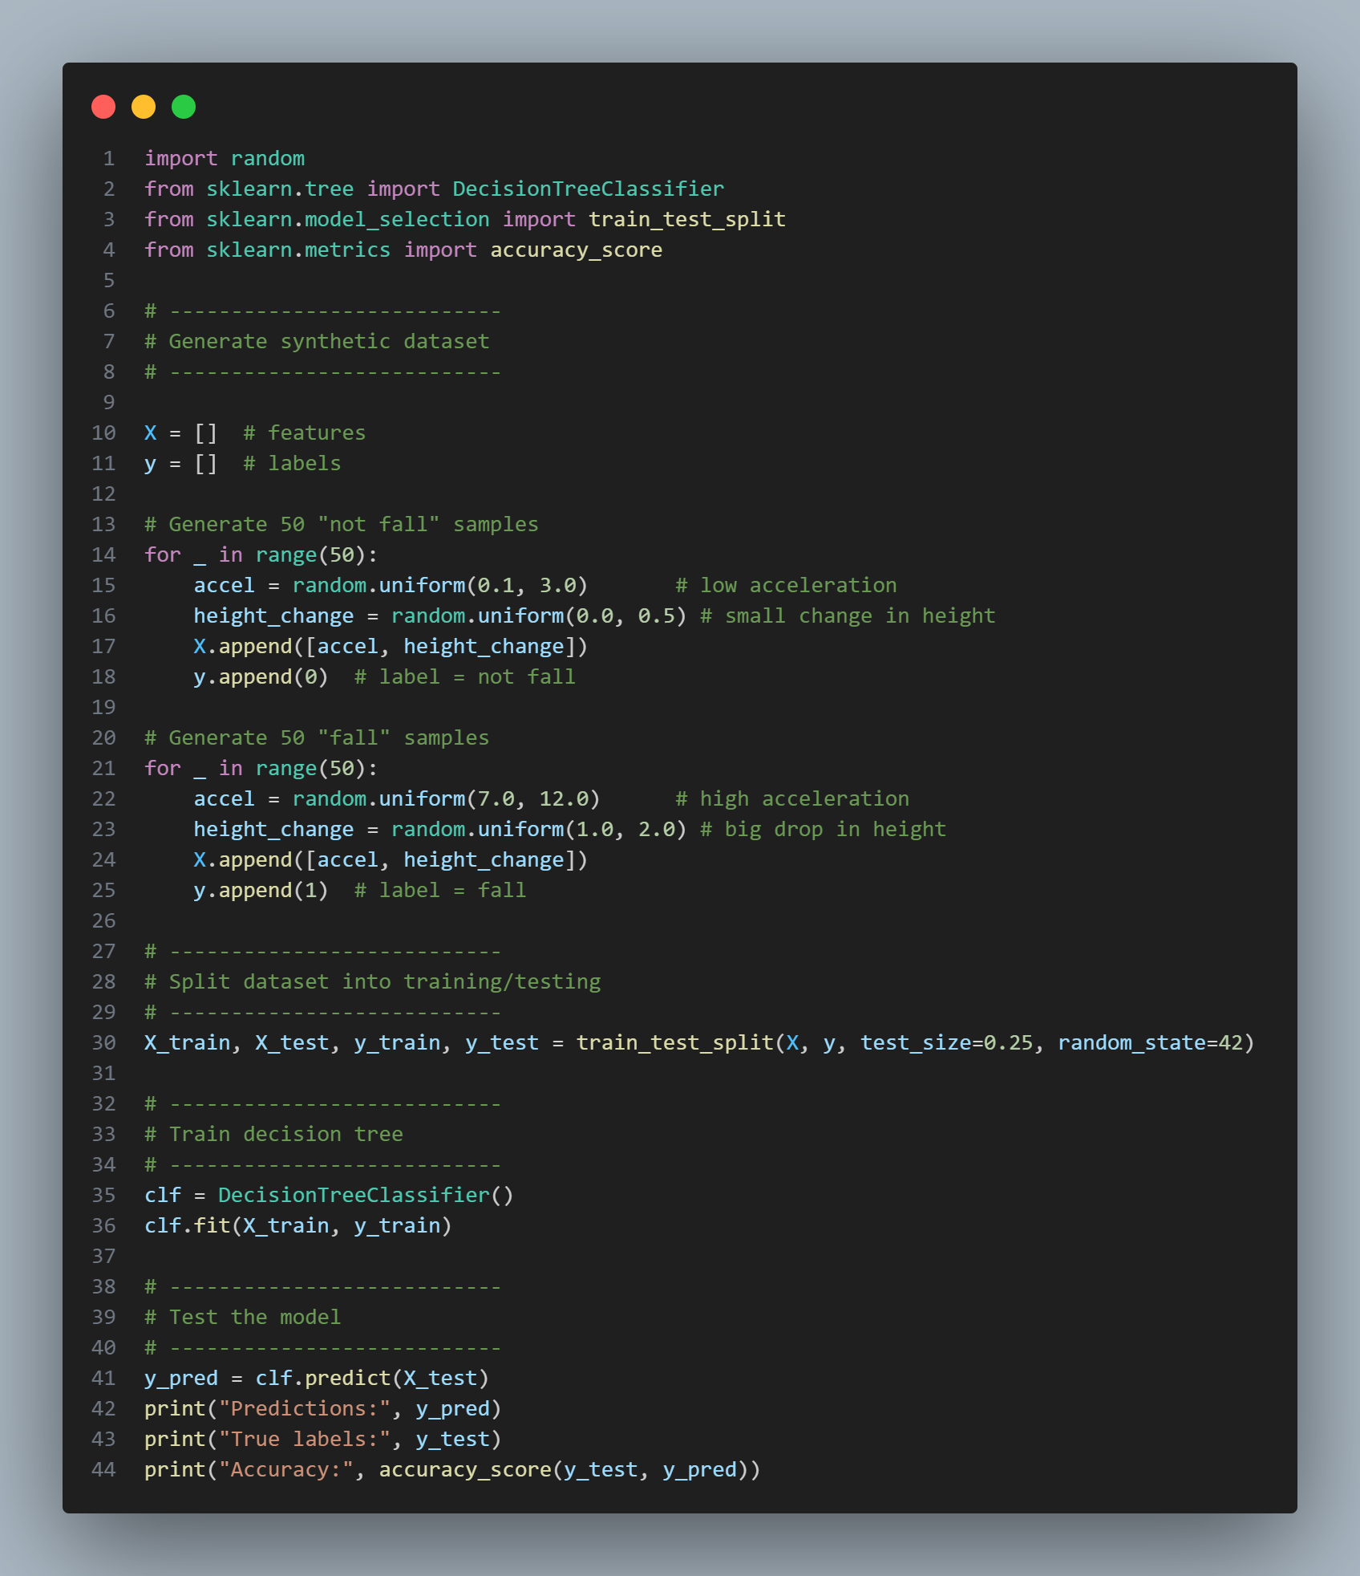
Data -
Matthew Blackwell
What has been accomplished by Data? | Challenges going into Capstone Blitz
Installed Raspberry Pi OS and established GitHub Created a simple decision tree ML model using dummy data | Artificial Neural Networks vs. Simple ML model Obtaining datasets to train the ML model

Slide 11
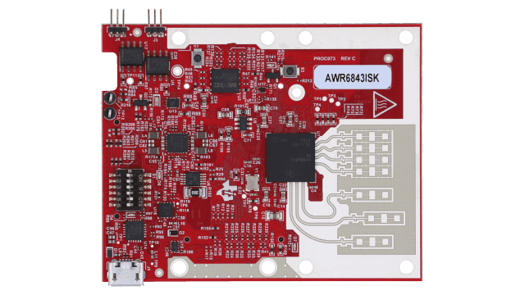
Wireless – Mitch Hoffman
Radar (AWR6843ISK)
Subsystem Function:
Processes motion data from radar and sends to Pi for fall detection
Design Overview:
AWR6843ISK
Spyder
Python
Constraints:
Interface compatibility
Radar reliability
Raspberry Pi 3
Mobile App

Slide 12
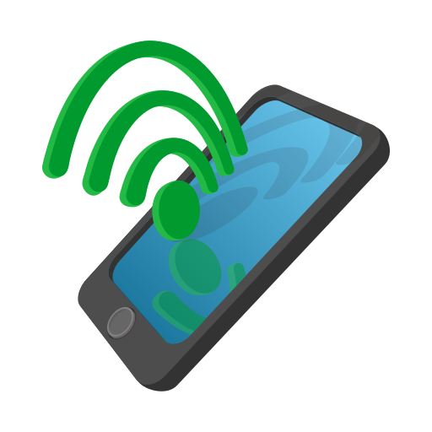
Wireless – Mitch Hoffman
Raspberry Pi 3
Subsystem Function:
Pi transmits fall alerts via Wifi to the cloud then to a mobile app for user notification
Design Overview:
Flutter
Constraints:
Reliable wireless communication
Minimalist app interface
Cloud
Mobile App

Slide 13
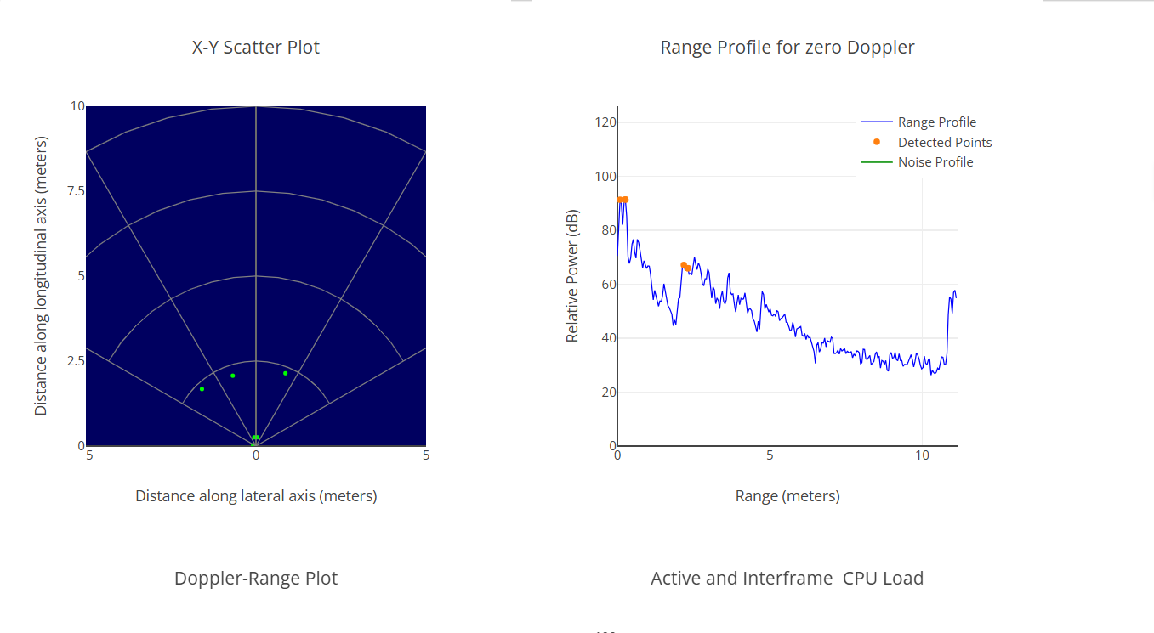
Wireless -
Mitch Hoffman
Accomplishments for wireless subsystem | Ongoing progress and plans until the next presentation
Decided on radar for device and demoed said radar Installed software to create app interface | Start code to process radar data needed for raspberry pi Develop a basic interface for the app

Slide 14
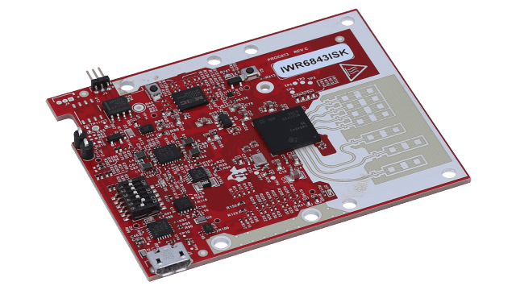
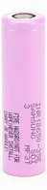
Physical – Wyatt Johnson
Power & Battery Subsystem:
Subsystem function:
Provide power, battery protection, and charging
Design Overview:
MCU/Control
Batteries
Power conversion
Monitoring
Altium
Constraints:
Battery Safety
Thermal management
Interface compatibility
3.7v 3500mAh

Slide 15
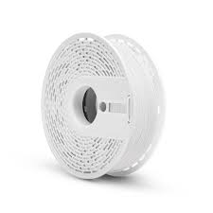
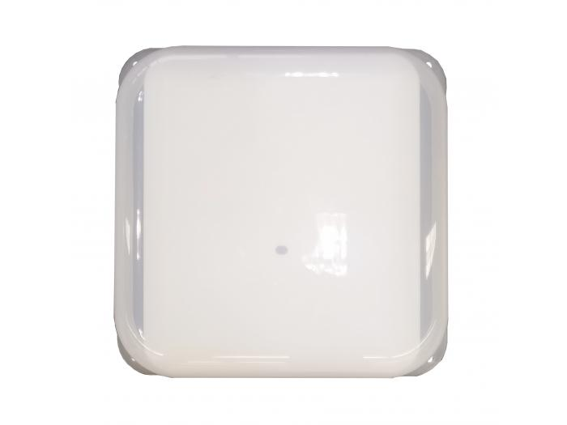

Radome:
Subsystem function:
Provide a visually appealing cover with minimal effect to radar signal.
Design Overview:
Housing made from RF-transparent materials
Proper mounting and alignment over system

Slide 16
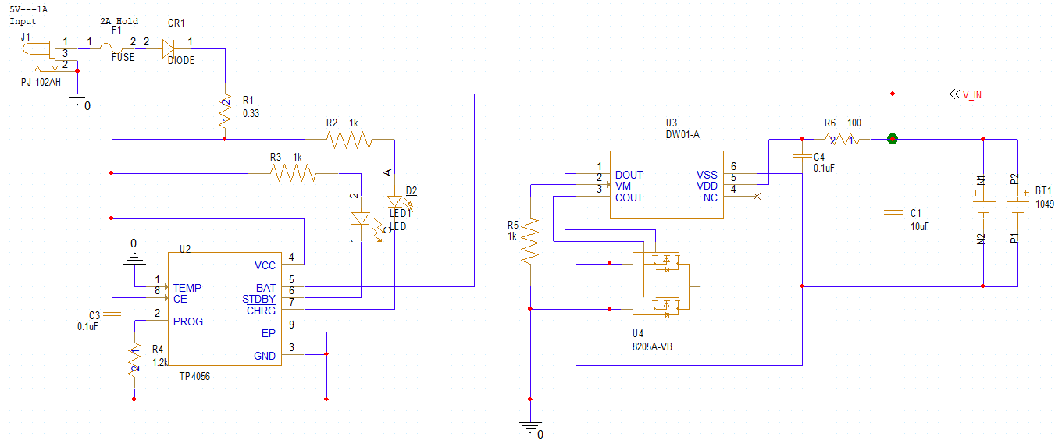
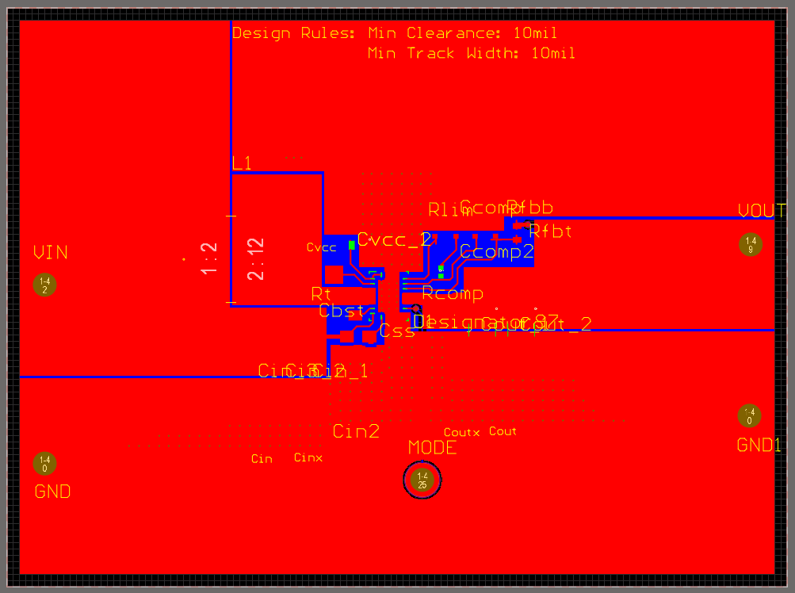
Accomplishments for Power System
Wyatt Johnson
Accomplishments for Power System | Ongoing work/next steps
Selected and ordered battery and supporting components Started PCB design in Altium Designed boost converter using TI WEBENCH Power Designer | Build prototype using perfboard and ordered components Characterize battery performance through testing Review and validate PCB design with faculty advisor

Slide 17
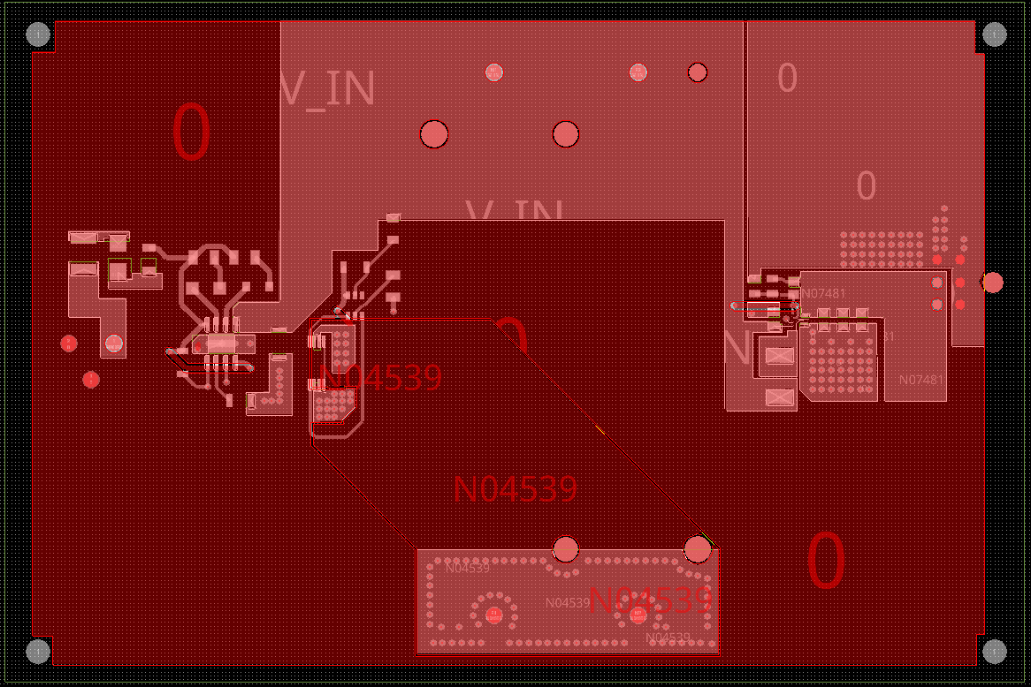
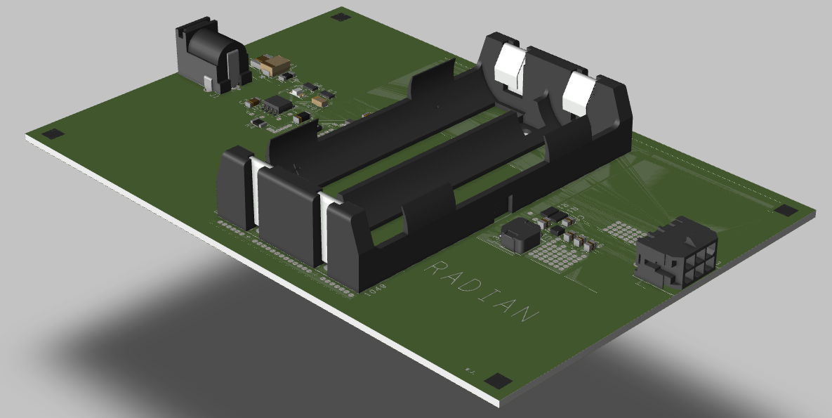
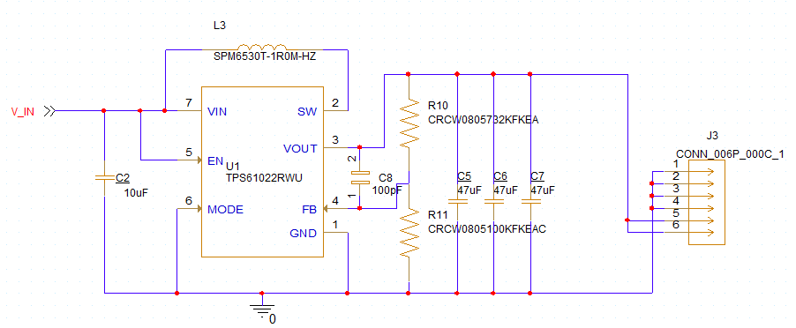
Accomplishments for Power System
Wyatt Johnson

Slide 18
Project Execution & Validation
List what needs to be completed in each subsystem by listed date … not just increasing % complete … subsystem parts designed, tested, validated by these dates
Accomplished so far and key planned engineering milestones
 | 8/25 - today | 10/6 | 10/20 | 11/3 | 11/17
Subsystem 1 (Owner) | Used WEBench to select and simulate a Lipo to 3.3V DC-DC converter | Design X | Test X, Design Y | Test Y | Validate X, Y, Z
Subsystem 2 (Owner) | Acquired dev board and have blinking LED working | Design X | Test X, Design Y | Test Y | Validate X, Y, Z
Subsystem 3 (Owner) | Installed Android Studio, starting simple landing page | Design X | Test X, Design Y | Test Y | Validate X, Y, Z
Subsystem 4 (Owner) | Installed Ardupilot Mission Planner | Design X | Test X, Design Y | Test Y | Validate X, Y, Z

Slide 19
Project Execution & Validation
 | October 1st | October 18th (Design Blitz) | October 28th | November 18th | December 2nd
Data - Matthew Blackwell | Simple ML model created using decision tree and dummy data | Decision between decision tree/random forest or Artificial Neural Network | Test with basic data for either ANN or other ML data model and obtain intended training data | Test obtained data with chosen ML model | AI model within 5% accuracy of chosen data parameters
Physical - Wyatt Johnson | Have all parts selected and working with boost converter | PCB designed and ordered | Assemble initial battery pack and test basic power delivery to system | Run extended runtime test, measure voltage stability and temp, verify standby mode | Connect power to full system, verify status reporting to Mobile app, Final safety checks, all documentation and test reports done.
Wireless - Mitch Hoffman | Be able to demo AWR6843ISK and have app interface started | Have basic app interface and have pi able to receive data from radar | Have app be able to receive test alerts | Have app interface working with the cloud | Try to integrate with Pi

Slide 20
Questions?

